Slide 1

Spark
Zewail City of Science and Technology
Communications and Information Engineering (CIE) Program
Big Data Analytics (CIE 427) - Fall 2020
Original by: Muhammad Hamdy AlAref

Slide 2
Overview

Slide 3
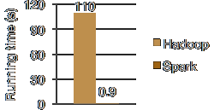
Why Spark?

Slide 4
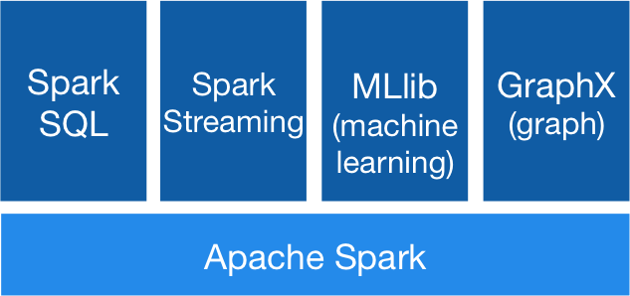
Spark Components

Slide 5
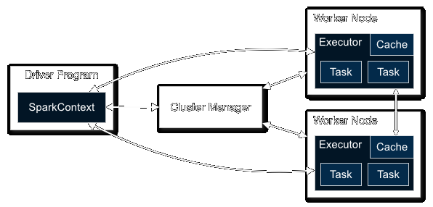
Spark Architecture
Notes:
Cluster Mode vs Client Mode

Slide 6
Resilient Distributed Datasets (RDDs)

Slide 7

Overview
Unlike the MapReduce framework, Spark data flow is NOT linear! Instead, the data exist in a form called Resilient Distributed Datasets (RDDs).
RDDs are created from data sources, e.g., files, or from other RDDs via applying transformations.
The execution of transformation is lazy, that is, it is only done when actions are taken!
Spark supports both job submissions and interactive shell!

Slide 8
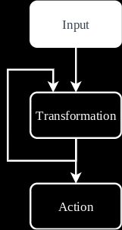
Input
parallelize creates an RDD from an iterable.
textFile creates an RDD from one or more text files; one record per line per file.
wholeTextFiles creates an RDD from multiple text files; one record per each file (filename, content).
More built-in options are possible!

Slide 9
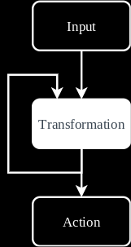
Transformations
map(func: value → value)
flatMap(func: value → values)
mapPartitions(func: values → values)
filter(func: value → bool)
union(RDD) - intersection(RDD) - distinct

Slide 10
Key-Value Transformations
reduceByKey(func: (value, value) → value)
groupByKey - aggregateByKey - sortByKey
join(RDD) - cogroup(RDD)

Slide 11

Actions
reduce(func: (value, value) → value)
foreach(func: (value) → void)
saveAsTextFile(path)
collect - take(n) - takeOrdered(n)
takeSample(withReplacement, n)
first - count
countByKey (only available with key-value RDDs!)

Slide 12
Shuffle
Shuffle is the name of Spark’s redistribution mechanism.
It is required by most key-value operations.
A LOT of disk and network IO operations are involved which implies significant performance impact.

Slide 13
Persistence
RDDs are fault-tolerant and they can persist to be used more than once without needing to recompute or reload them.
RDDs can persist in memory and/or disk.
Memory persistence is recommended as long as the data can fit in the cluster’s collective memory!
Persistence in memory only is also known as cache.

Slide 14
Closures
Function closures are the surrounding state of the function with all the reference it has access to.
Attempting to change a non-local, e.g. global, variable is undefined and can yield different results on different clusters!
counter = 0 def increment_counter(x): counter += x rdd.foreach(increment_counter) print("Counter value: ", counter)

Slide 15
Shared Variables
Since “global” variables are not really cluster-global, Spark offers two limited form of sharing variables (general fully-functional shared variables is very inefficient)!
Broadcast read-only variables Broadcasted once and read by all the nodes.
Accumulators variables that can only be added together through an associative and commutative operation; arithmetic or user-defined.

Slide 16
Installation (Prebuilt for Hadoop 2.7)

Slide 17
Word Count Demo

Slide 18

Requirement: Simplified PageRank
Given a sample of the WDC Hyperlink Graphs, use Spark implement a simplified version of the PageRank algorithm using the following equation!
NOTE You can just use the arcs file and look up the domain names manually in the index file. Incorporating the index file to output the domain names directly gives you BONUS!

Slide 19
Acknowledgement
A lot of the material introduced in Spark Overview were adapted from the official Apache Spark homepage and documentation.
A lot of the material introduced in Resilient Distributed Datasets (RDDs) were adapted from the official Apache Spark documentation.

Slide 20
Thank you!

